Slide 1
Regression Model (Predict Housing Prices)
Done By: Toh Kien Yu (P2222291)

Slide 2
Roadmap
Nature Of Datasets
Data Exploration
Data Preprocessing
Algorithms Used
Test And Score (Before Tuning)
Hyperparameter Tuning
Test and Score (After Tuning)
Feature Importance
Dummy Baseline
Conclusion

Slide 3
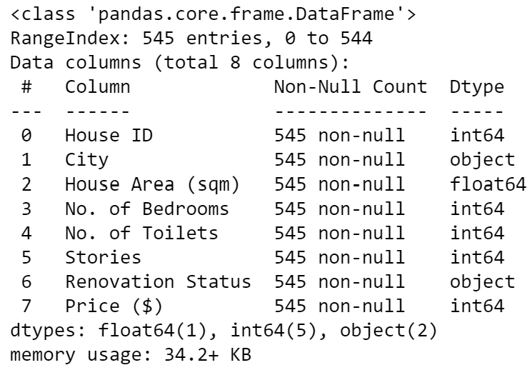
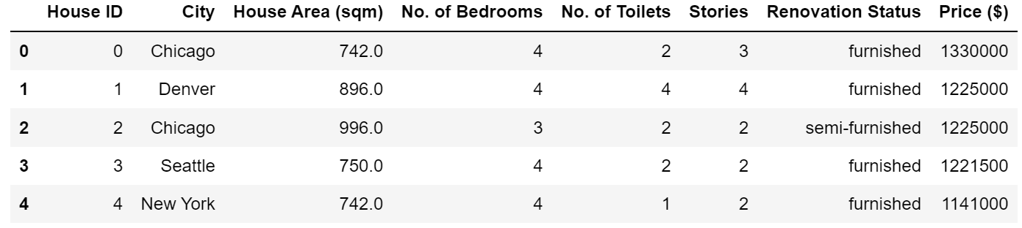
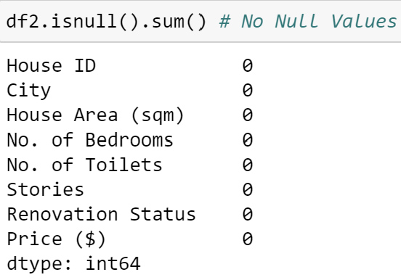
Nature of Dataset
(545 rows, 8 columns)
Categorical Data
City
Renovation Status (‘univeresity’, post-graduate, high school)
Numeric Data
House ID
House Area (sqm)
No. of Bedrooms
No. of Toilets
Stories
Price ($)
Imputation is not needed

Slide 4
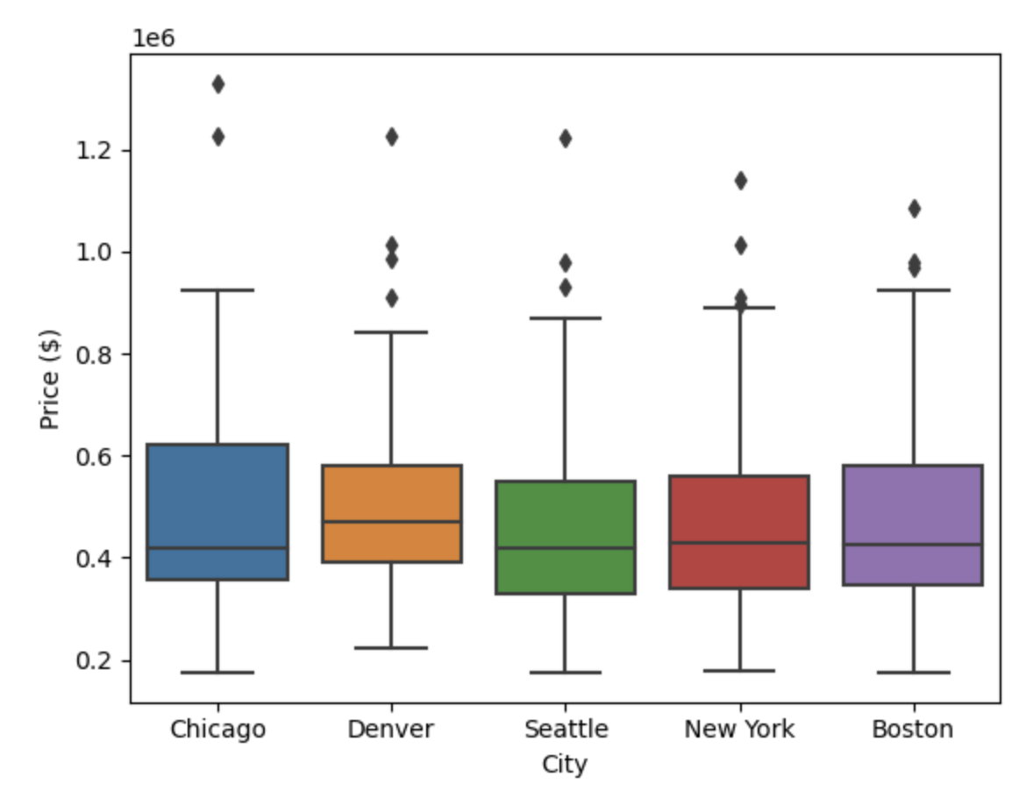
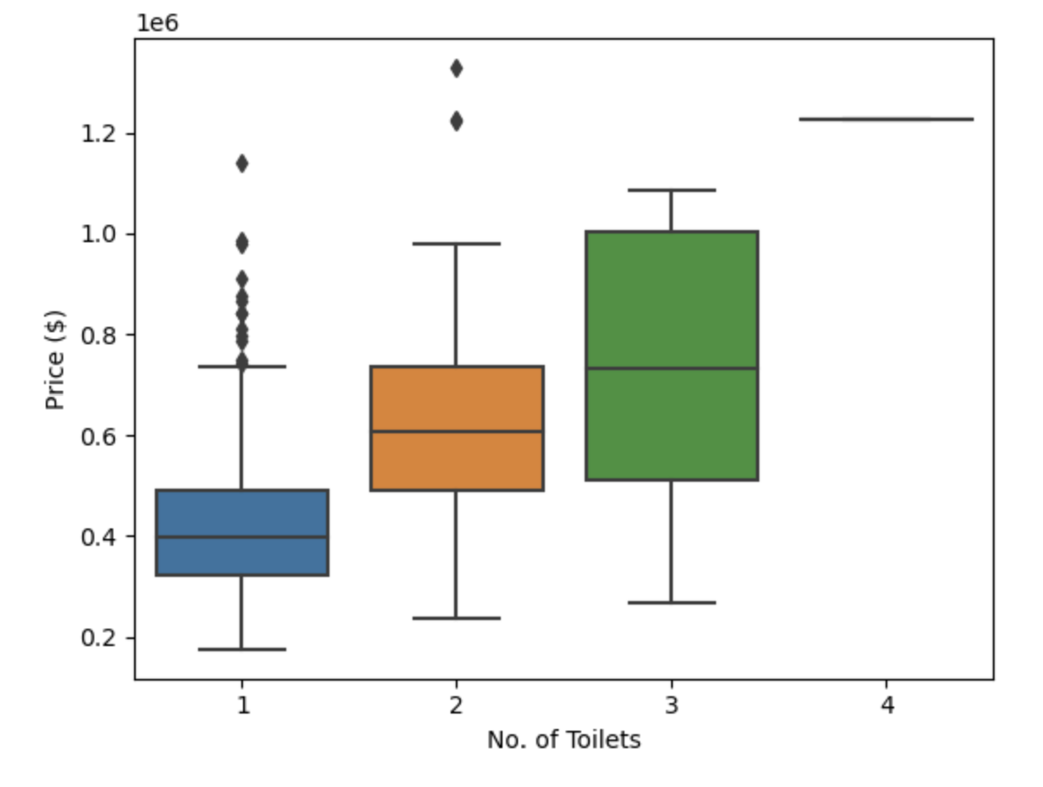
Data Exploration
Median housing prices are around the same price with Denver having the highest median housing price.
Median housing prices increases as the number of toilets in the house increase.

Slide 5
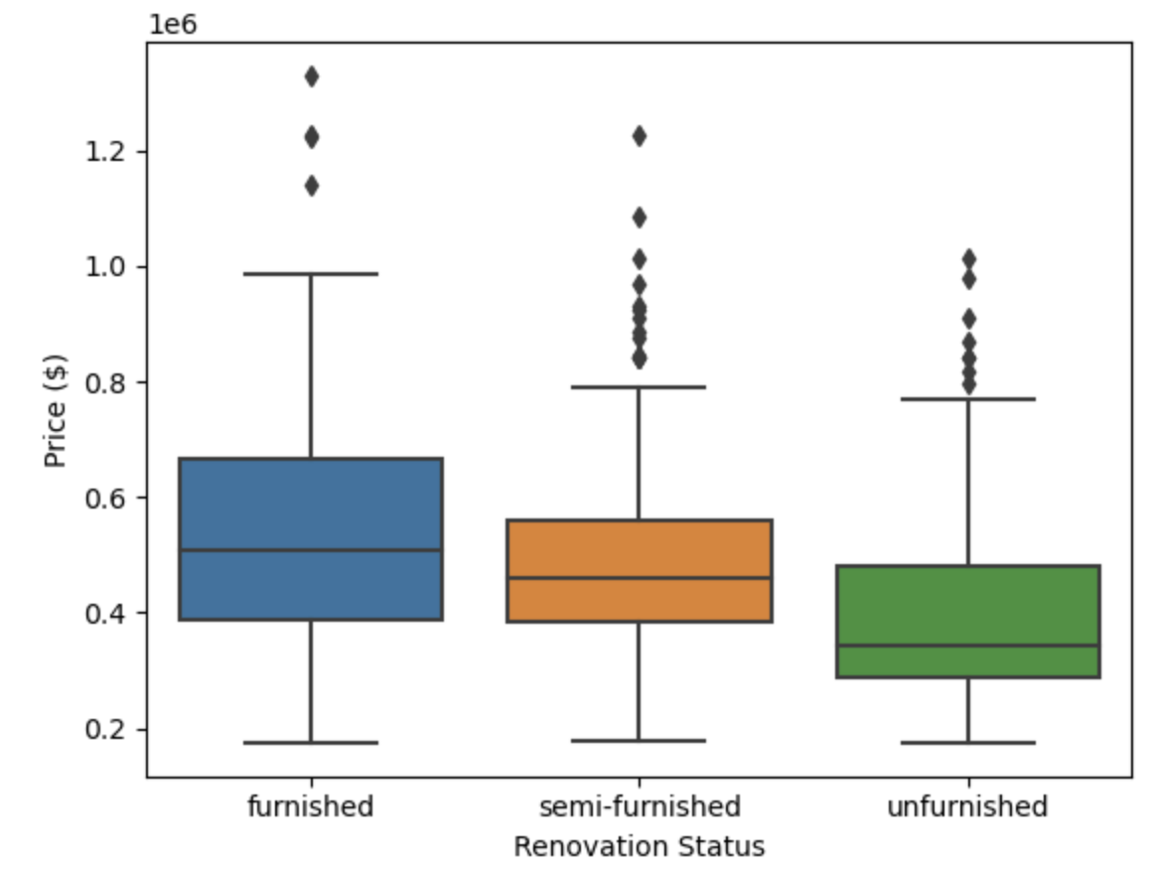
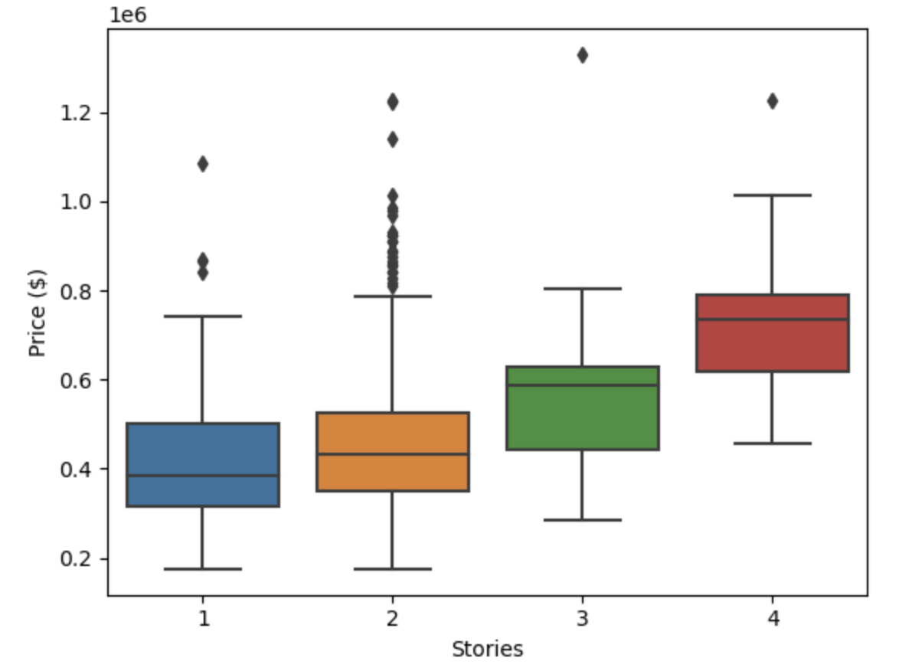
Data Exploration
Median housing price for furnished is typically the highest, followed by semi-furnished then unfurnished
Median housing prices increases as the number of stories in the house increases

Slide 6
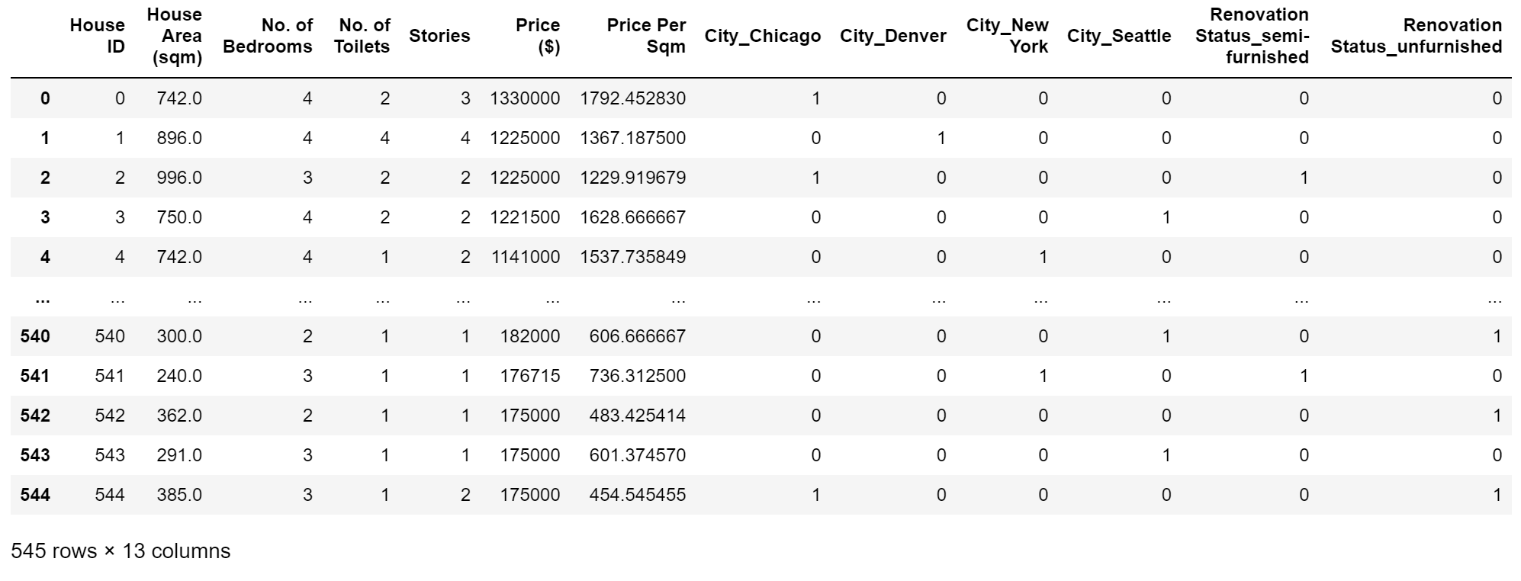

Data Preprocessing, Feature Engineering and Feature Selection
1. Encoding Categorical Variable
Feature Engineering
Feature Selection
- Price Per Square Meter column was created to increase the predictive power of the algorithm.
X drops the target variable (‘Price ($)’) and identifying column (‘House ID’).
y is the target variable
(‘Price ($)’)

Slide 7
Algorithms Used
Gradient Boosting Regressor
Gradient Boosting for Regressor
Lots of flexibility, many options to choose from when hyperparameter tuning
Linear Regression
Random Forest Regressor
Gradient Boosting Regressor
HistGradientBoosting Regressor
Decision Tree Regressor
Extra Tree Regressor
HistGradientBoosting Regressor
- Is a Histogram-based Gradient Boosting Regression Tree
Linear Regression
Predict continuous variable
Easy to implement
Handles overfitting well
Extra Tree Regressor
Creates many decision trees and sampling of trees is random.
Reduction in bias
Decision Tree Regressor
Tree with decision nodes
Not easily affected by outlier
Random Forest Regressor
A Random Forest Regressor
Easy to interpret
Lots of flexibility, many options to choose from when hyperparameter tuning

Slide 8
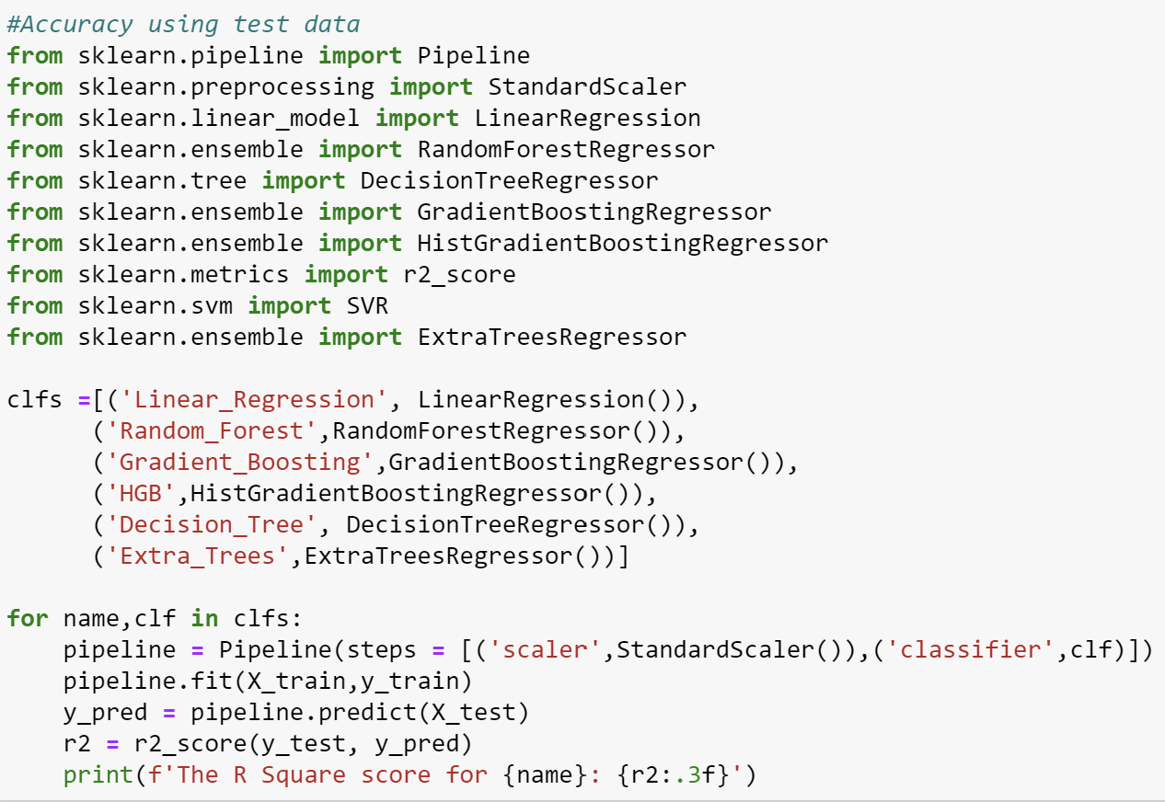
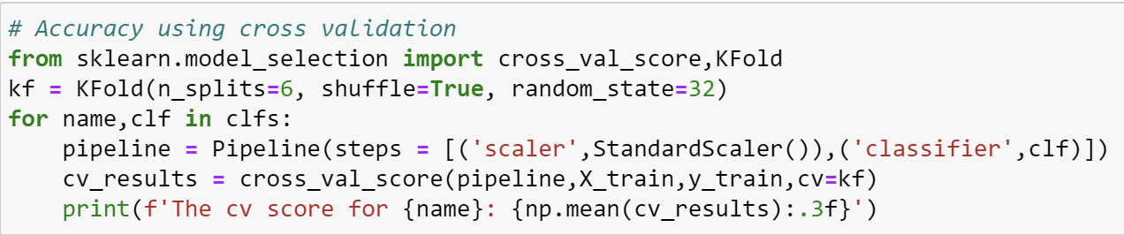
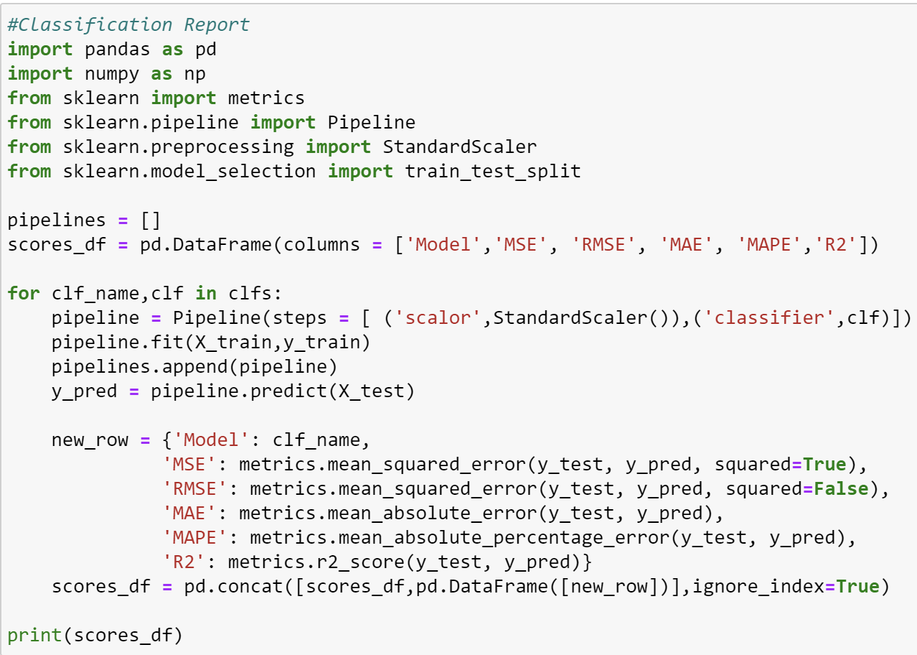
Test and Score Code (Before Hyperparameter Tuning)

Slide 9
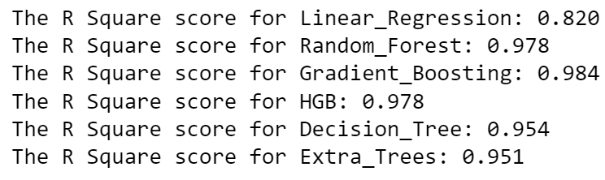
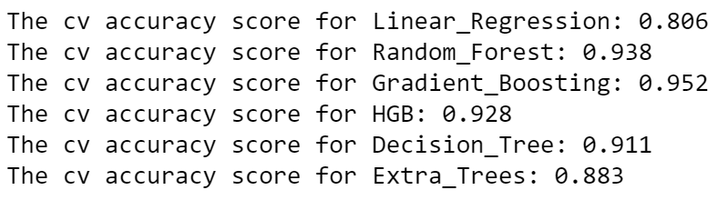
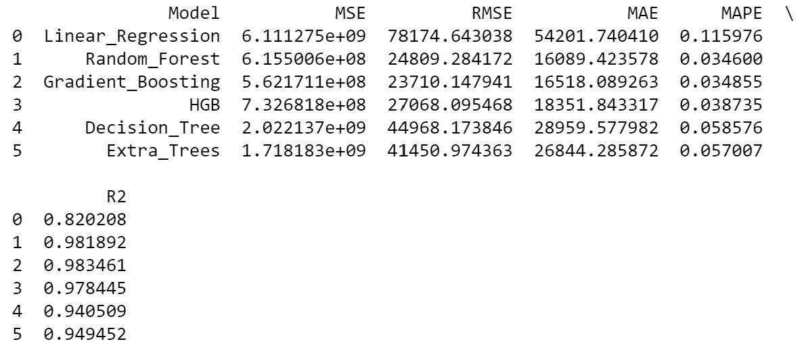
Test and Score (Before Hyperparameter Tuning)
Splitting Of Train And Test Data
An 80:20 ratio between training and test data is chosen where 80% of the data is for training and 20% is for testing
R Square Score Using Test Data
R Square Score Using Cross Validation
From the test and score results, all models achieve a very high R square score of 0.90+ except for linear regression with a R Square score of 0.80+.
Gradient Boosting Algorithm has a highest R Square of 0.984 tested on test data compared to the other algorithms. This tells us that the model able to explain 98% of the variance whether one will default payment.
Not only that, it also has the highest cross-validation score of 0.952
Classification Report

Slide 10
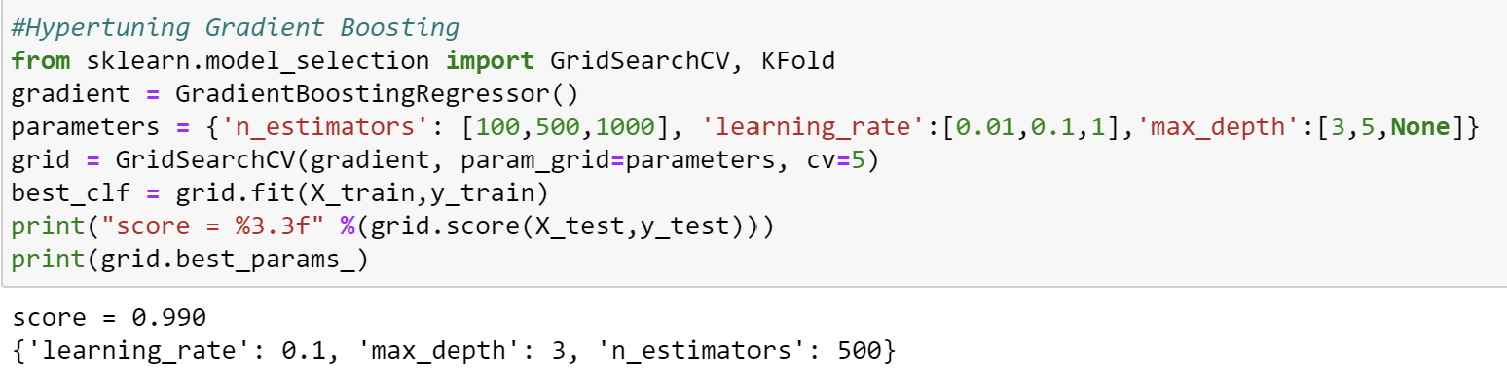
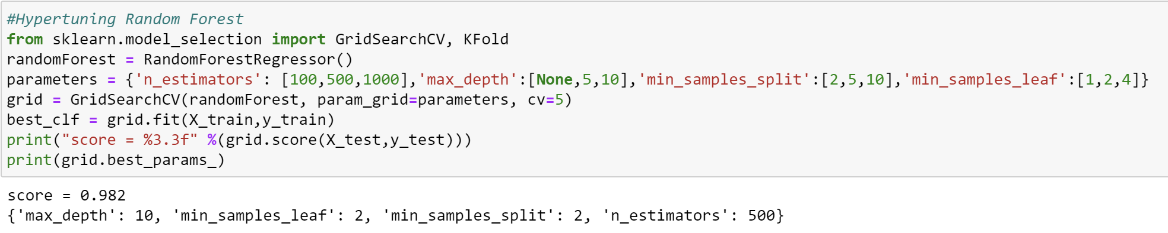
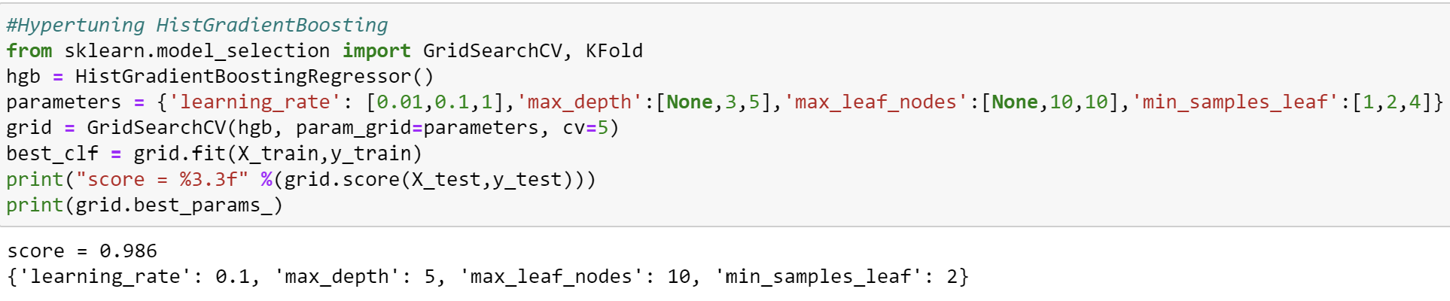
Hyperparameter Tuning
Picked out 3 of the most accurate model to hyperparameter tune.
Gradient Boosting
Random Forest
HistGradientBoosting
Now, I will hyperparameter tune the model to further improve the accuracy by customising the parameters for the algorithm.
Define a param grid for each model, and parameters I would like to test
GridSearchCV will loop through all the different types of combinations.
Upon looping through all the combinations, it will provide me with the best parameter combinations and highest R Square Score obtained.

Slide 11
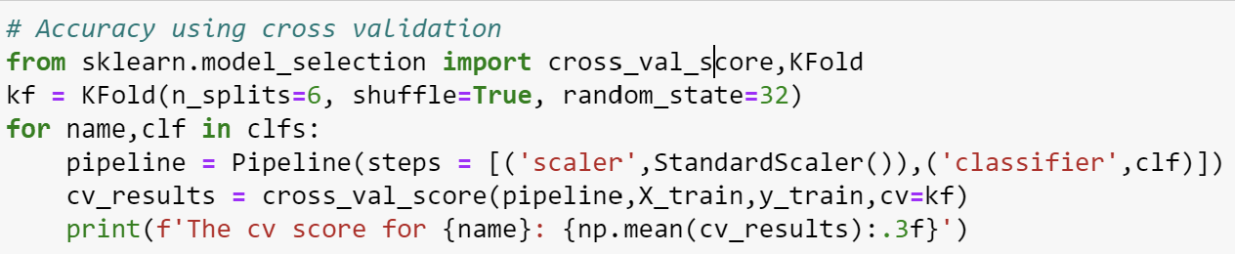
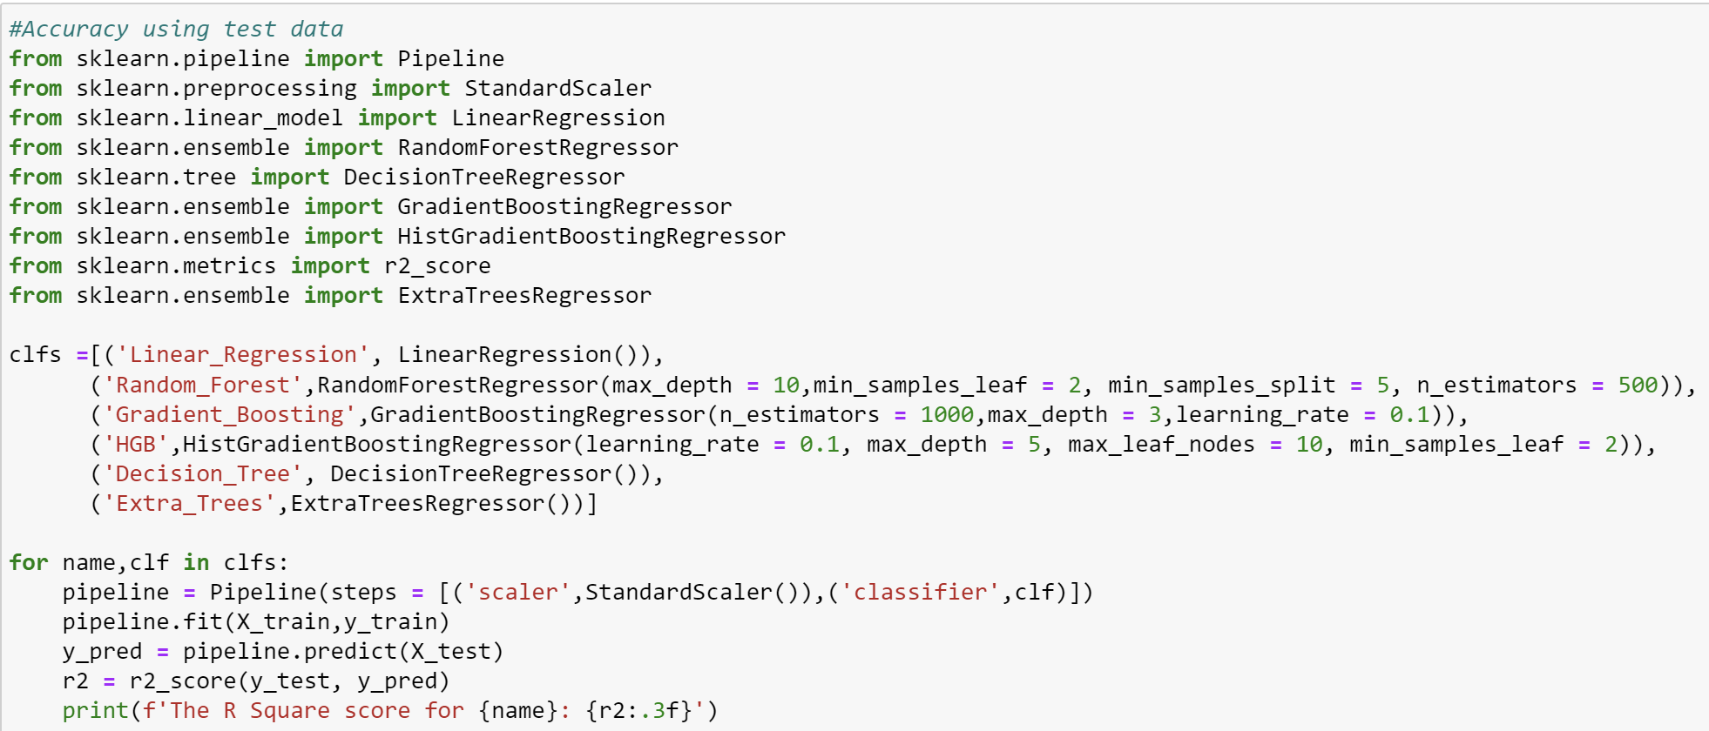
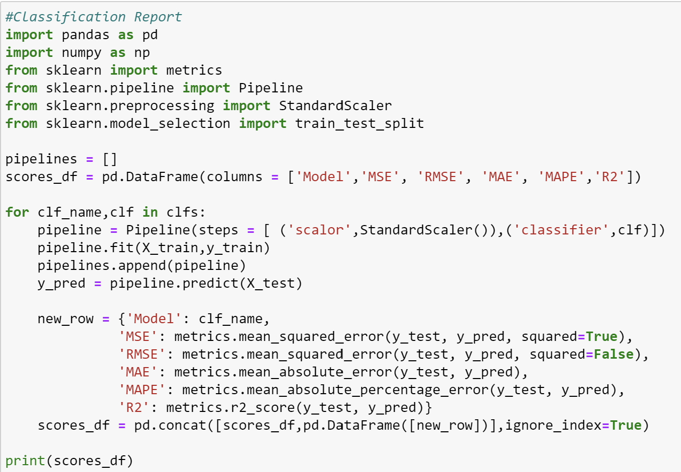
Test and Score Code (After Hyperparameter Tuning)

Slide 12
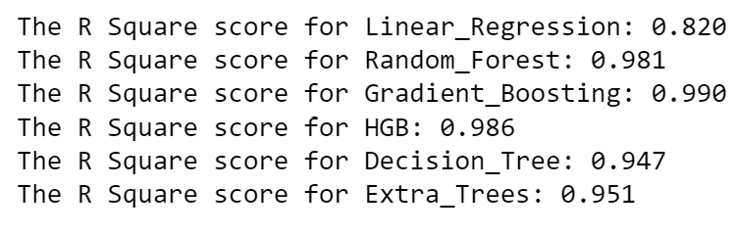
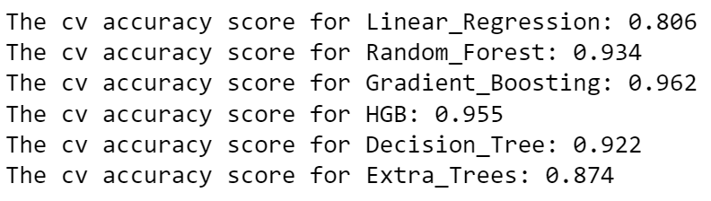
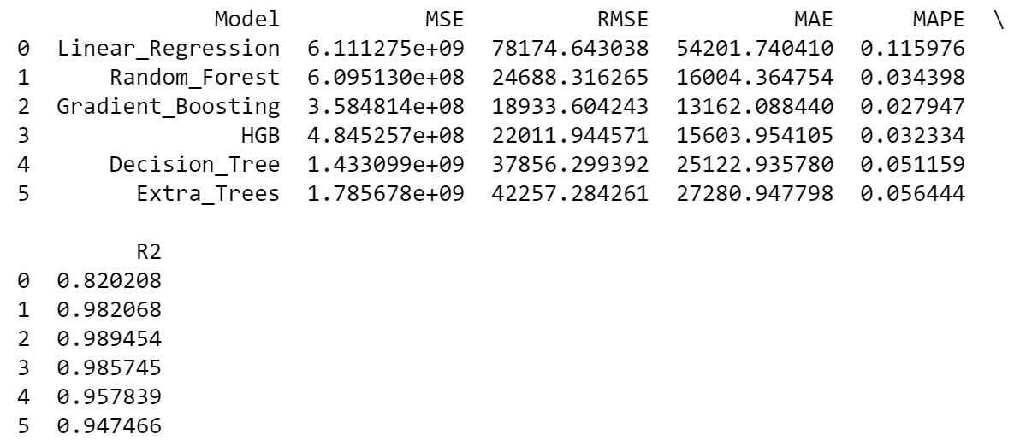
Test and Score (After Hyperparameter Tuning)
R Square Score On Test Data
After tuning the models,
Gradient Boosting
R Square Score on test data increased from 0.984 to 0.990.
Cross Validation Score increased from 0.952 to 0.962.
Random Forest
R Square Score on test data increased from 0.978 to 0.981.
Cross Validation Score decreased from 0.938 to 0.934.
Histogram Gradient Boosting
R Square Score on test data increased from 0.978 to 0.986.
Cross Validation Score increased from 0.928 to 0.955.
Overall, hyperparameter tuning has increased our model R Square Score in turn makes the model effective.
Cross Validation R Square Score
Classification Report
The MSE Score is of Gradient Boosting is the lowest.
The MAPE Score of Gradient Boosting is the lowest which tells us that on average, the model prediction differ by 2.7% from the actual value of housing prices.

Slide 13
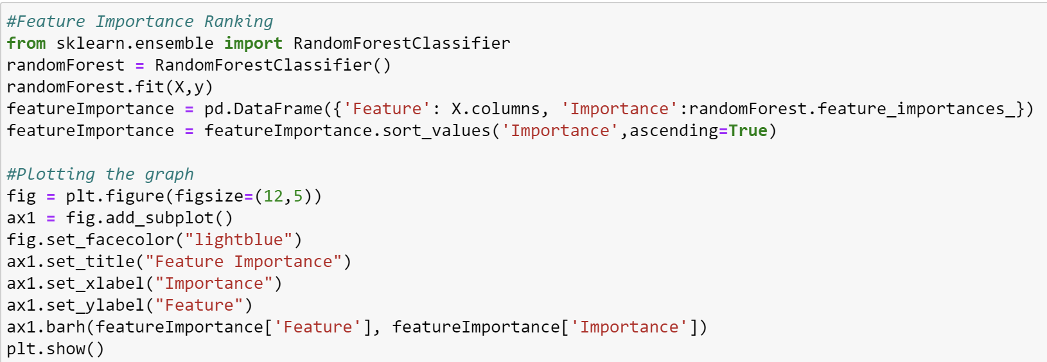
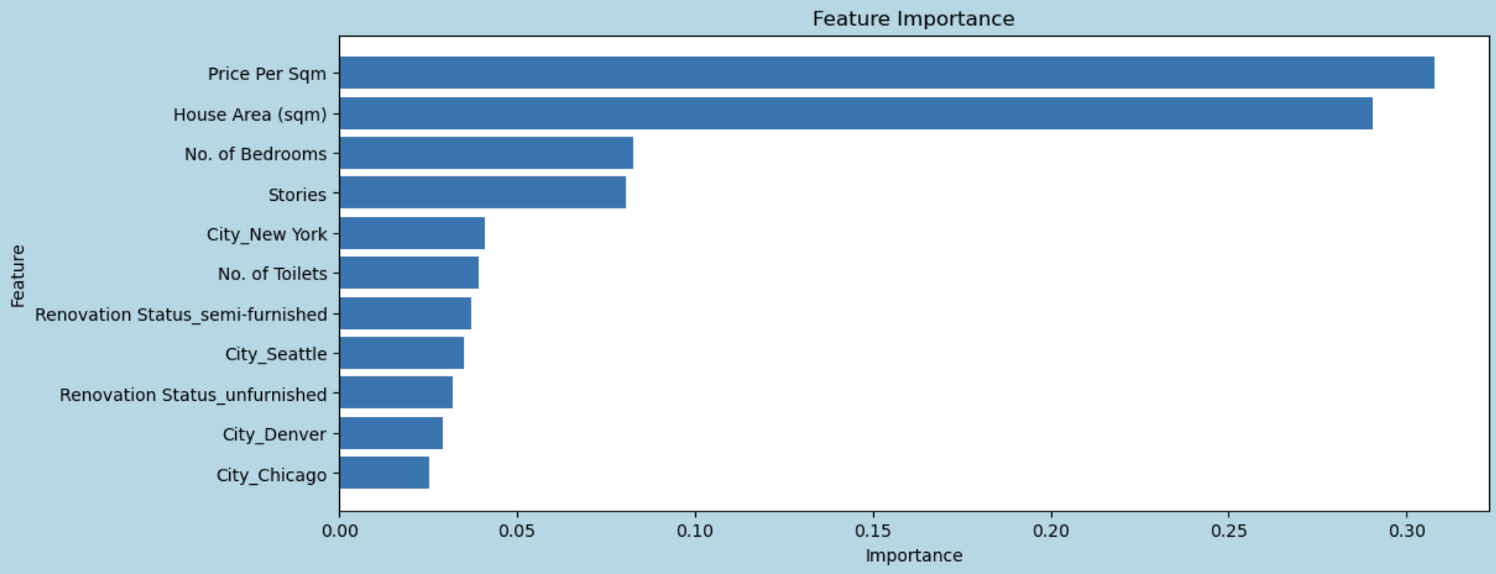
Feature Importance Graph Code

Slide 14
Feature Importance
From the Feature Importance Graph, the model heavily relies on the price per sqm and house area to predict housing prices.
Houses with higher price per square meter will be costlier.
Houses with bigger house area will be costlier

Slide 15
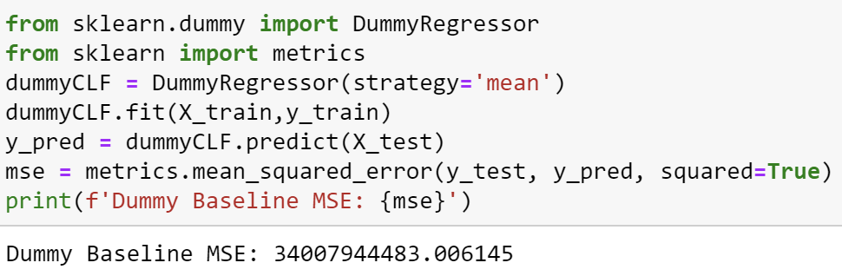
Dummy Baseline
Comparing my model to a dummy baseline, the Mean Square Error has decreased, and my Model’s R Square Score increased.

Slide 16
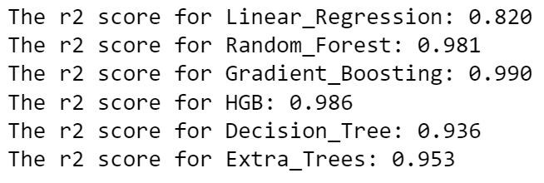
Conclusion
In Conclusion, this dataset has given me a deep understanding on the housing price in US.
My model is able to capture complex patterns in the data and make more accurate predictions about housing prices.
Upon considering all 3 different accuracy reports Gradient Boosting is my most accurate model to predict housing prices.

Slide 17
Thank You!

